Slide 1


Fundamentals of JavaScript
Internet Programming I: Lab VI
Addis Ababa Science and Technology University
Department of Software Engineering

Slide 2
Purpose of This Lab
The purpose of this lab is to:
Practice with fundamentals of JavaScript
Add features into your course project
Before this Lab !!
Be familiar with HTML basics
Refer https://www.w3resource.com for these and other more excercises

Slide 3
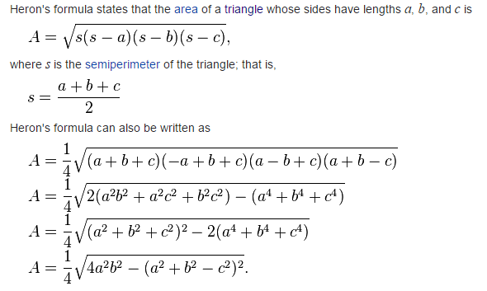
Exercise 1
Write a JavaScript function to find the area of a triangle where lengths of the three of its sides are 5, 6, 7.

Slide 4
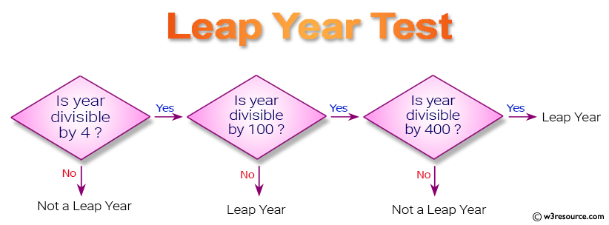
Exercise 2
2. Write a JavaScript program to determine whether a given year is a leap year in the Gregorian calendar.

Slide 5
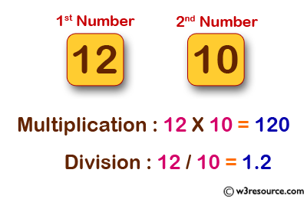
Exercise 3
Write a JavaScript program to calculate multiplication and division of two numbers

Slide 6
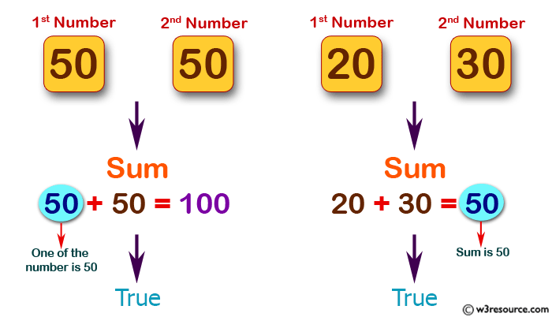
Exercise 4
Write a JavaScript program to check two given numbers and return true if one of the number is 50 or if their sum is 50.

Slide 7
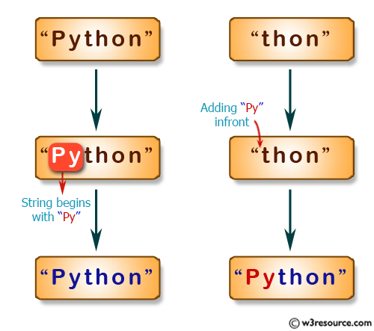
Exercise 5
Write a JavaScript program to create a new string adding "Py" in front of a given string. If the given string begins with "Py" then return the original string.

Slide 8
Working on Your Project
Apply everything you know on your course project

